Slide 1
ENCA not Cleaning Agent —— a cleaning agent picker
Agenda
Introduction (Haoze Zhang)
Business Logic Structure (Zhaowen Gong)
Data Access and Testing (Zeling Wu)
Android application (Xiaoqi Ma)
Demo

Slide 2
Team
Haoze Zhang Requirement analysis, system structure, UI design and team collaboration.
Zhaowen Gong Business logic implementation, UI implementation and code revision.
Zeling Wu Data acquisition, database management and testing.
Xiaoqi Ma Android application, UI design and implementation.
Collaboration platform: GitHub: https://github.com/Nimita311/ENCA-Andriod

Slide 3
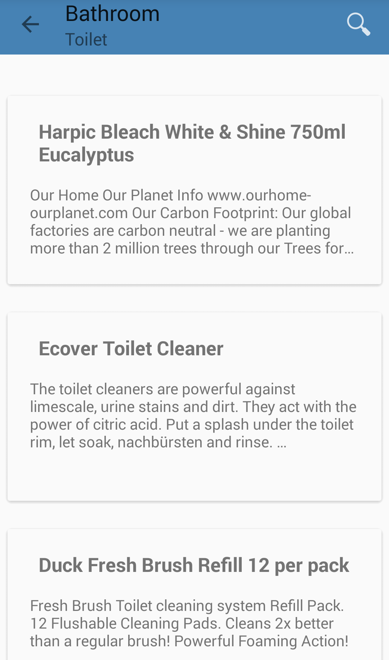
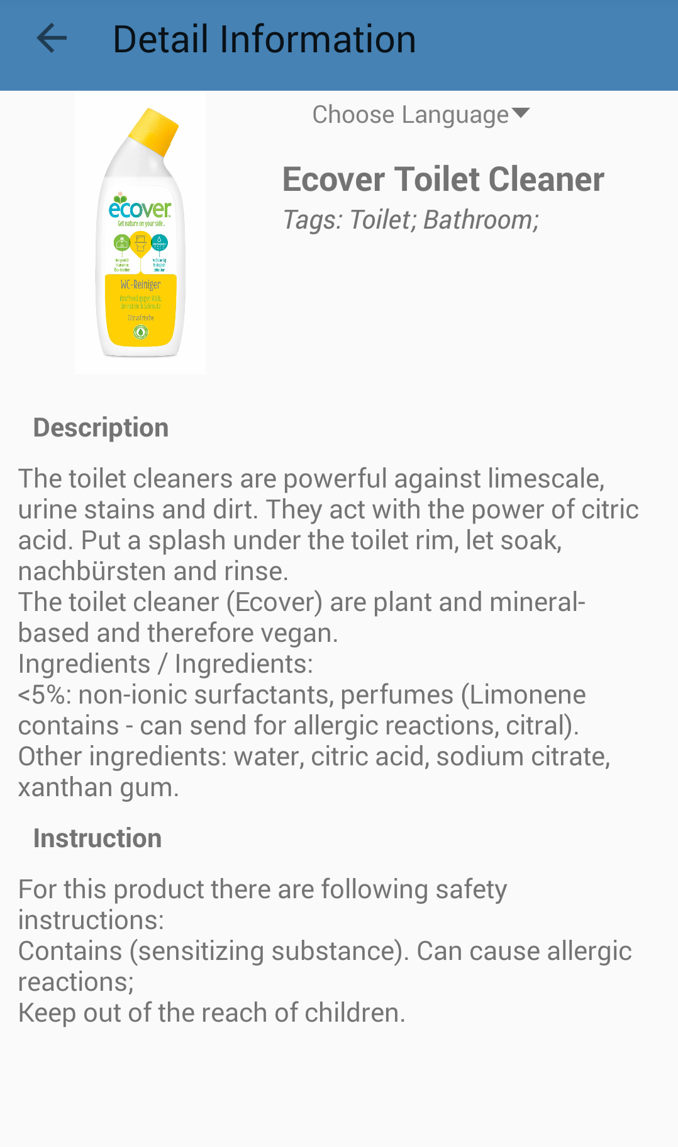
Additional Task
Android: ENCA express

Slide 4
Scenarios of Use
Scenario 1: (with ENCA) Cleaning purpose -> Cleaning agent
Scenario 2: (with ENCA) Cleaning agent's name or description -> Cleaning agent
Scenario 3: (with ENCA-express) Want to buy a cleaning agent -> show the seller

Slide 5
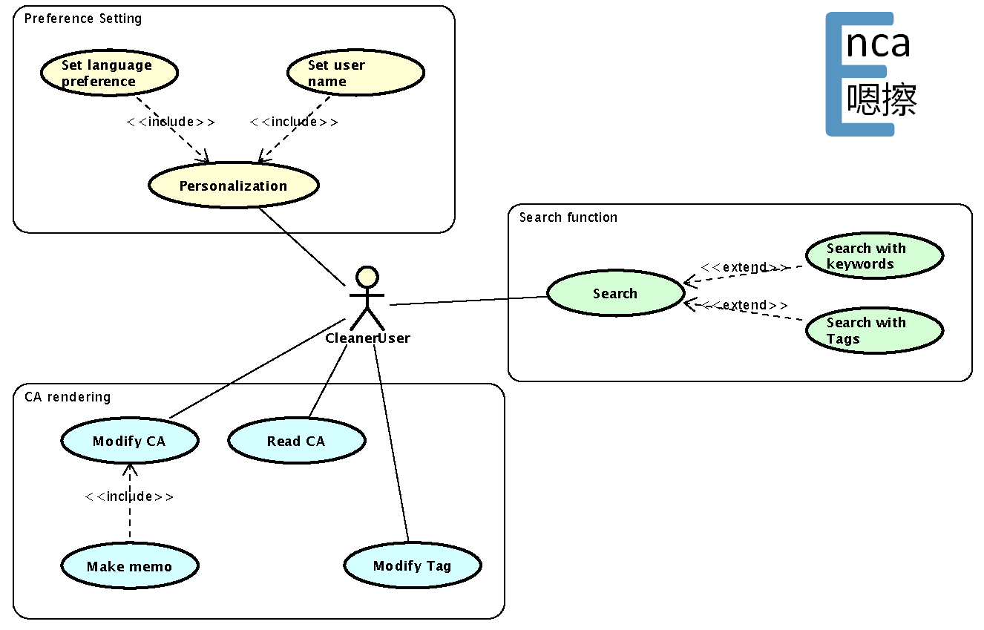
Use Case Diagram

Slide 6
MVC

Slide 7
Languages

Slide 8
Preferences

Slide 9
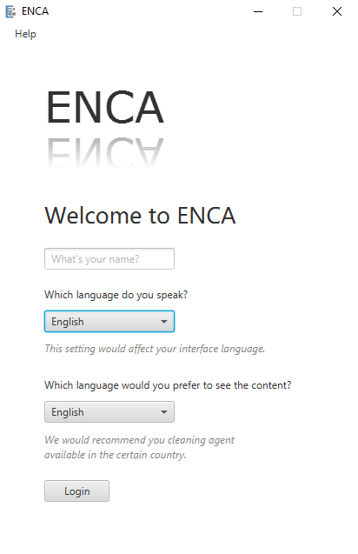
JavaFX
Clear structure
Main class
FXML file expressing interface
Separate controller
Css file controlling style
Better look
Flat design
Theme color: Still Blue, RGB(70, 130, 180)
Tag colors:
More flexible layout
Consistency
Room
Items
Others

Slide 10
Data Access

Slide 11
E-R Diagram

Slide 12
Test
Unit Test InternationalStringTest
Module Test SQLAmenderTest, SQLVisitorTest
Integration Test TagOperatorTest

Slide 13
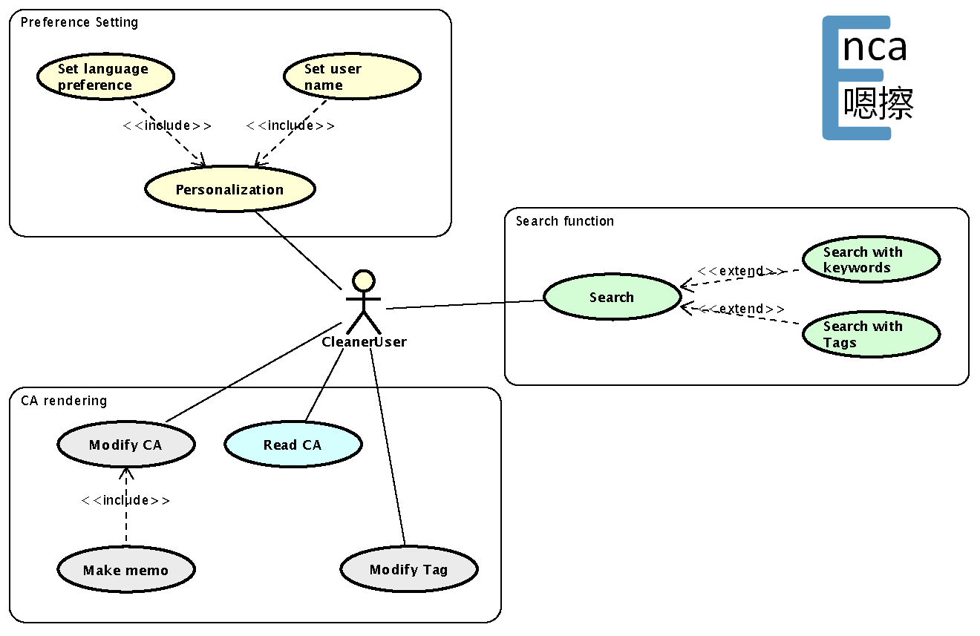
Android

Slide 14
DEMO

